Slide 2
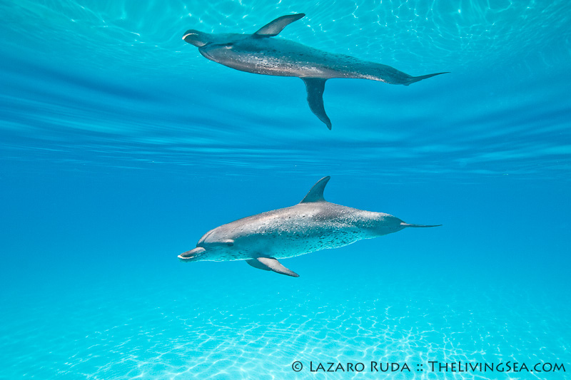
Total Internal Reflection

Slide 3
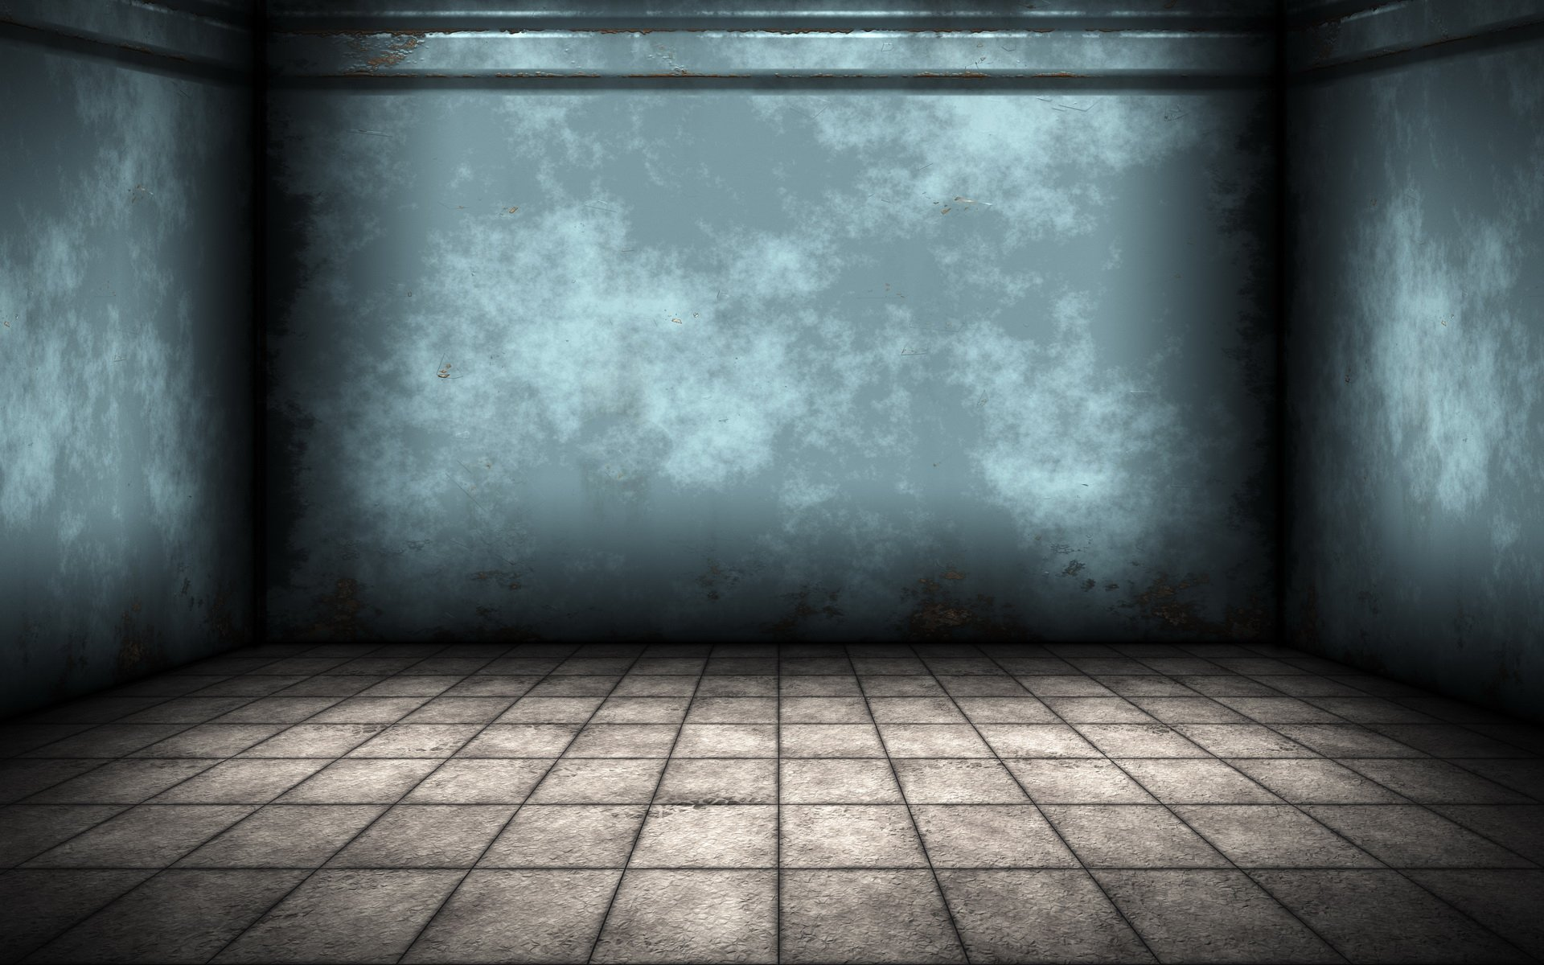
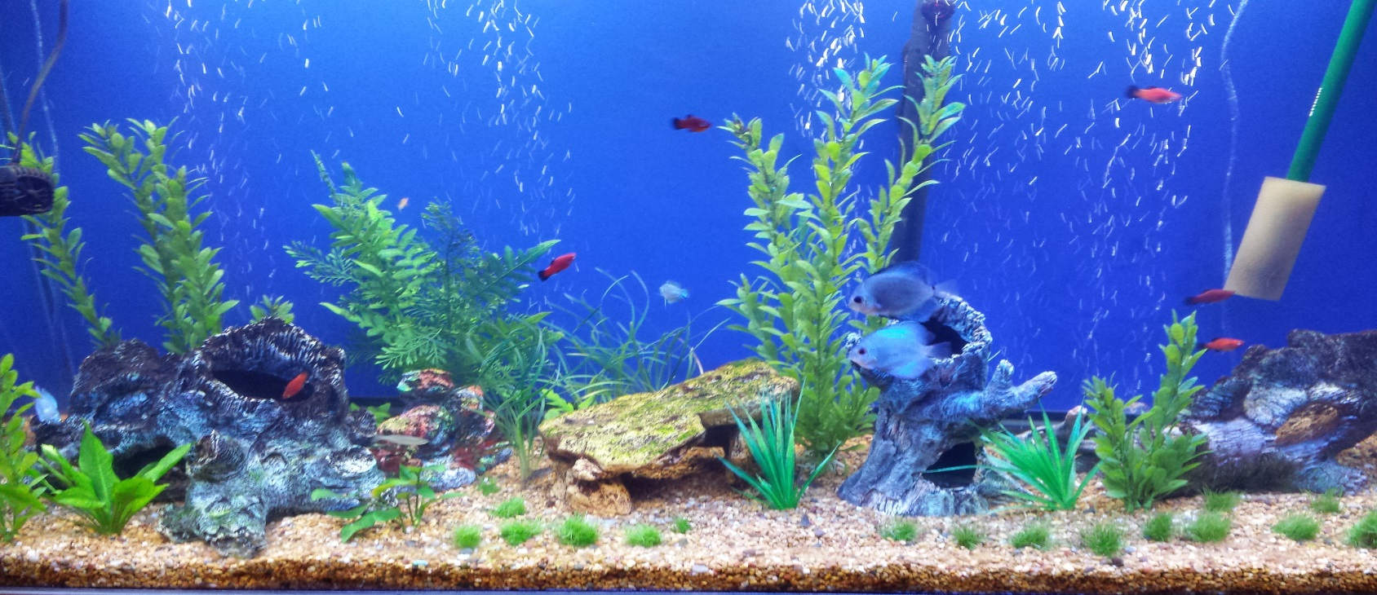
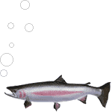

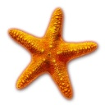
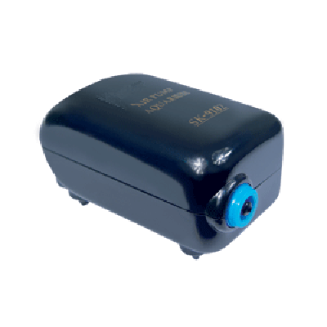

Partial and total internal reflection
Critical angle
angle of incidence
angle of refraction is 90°
50°
70°
> 90°
35°
40°
45°
30°
Total internal reflection
Partial reflection

Slide 4
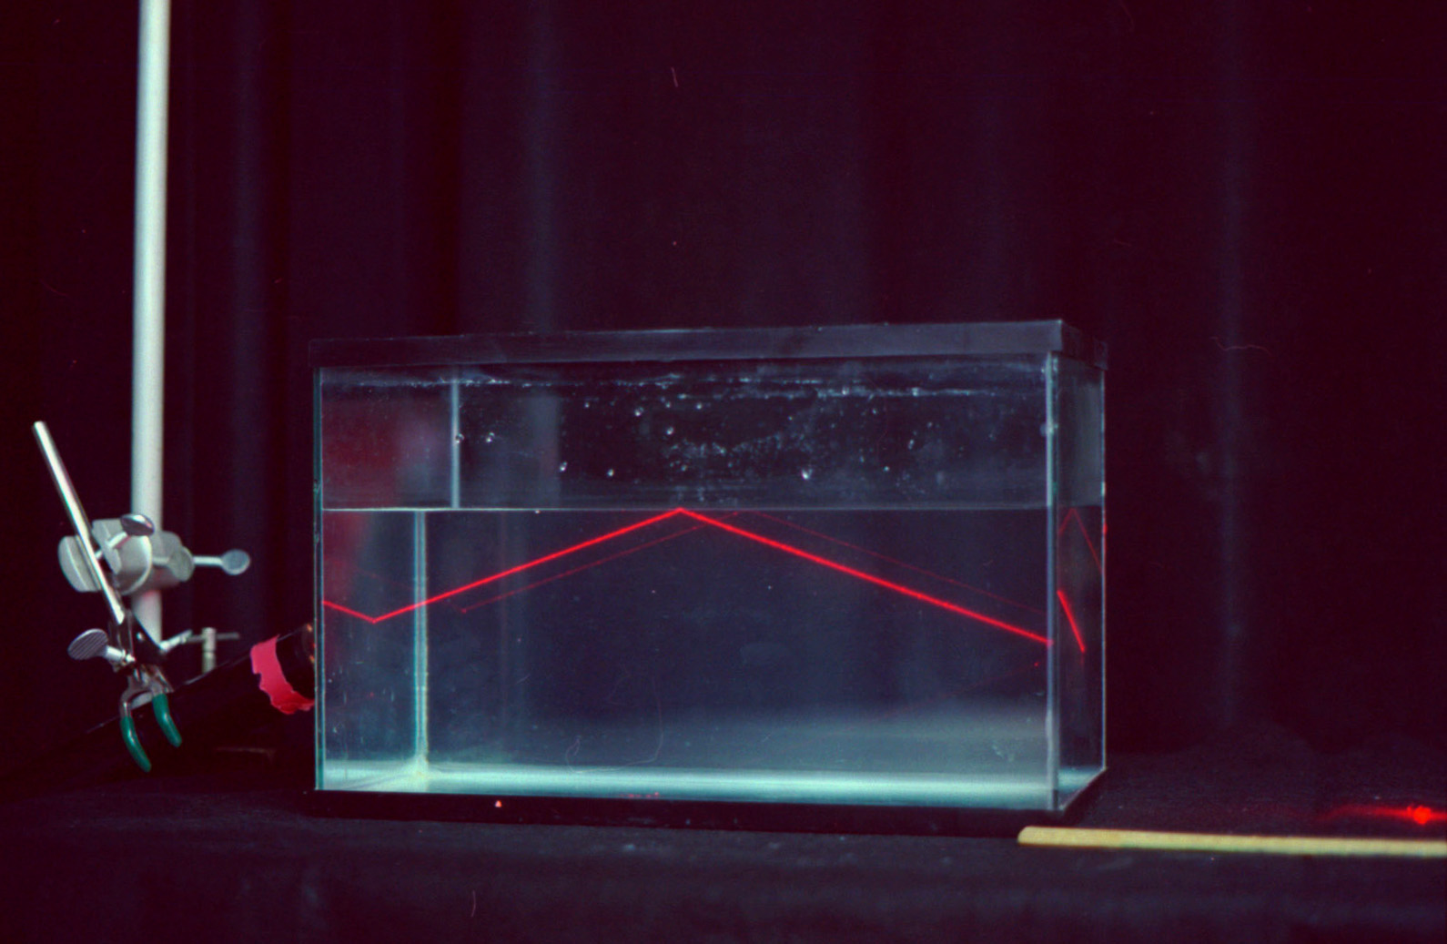

Experiment showing Total Internal Reflection
Ray of light getting reflected from surface of water

Slide 5
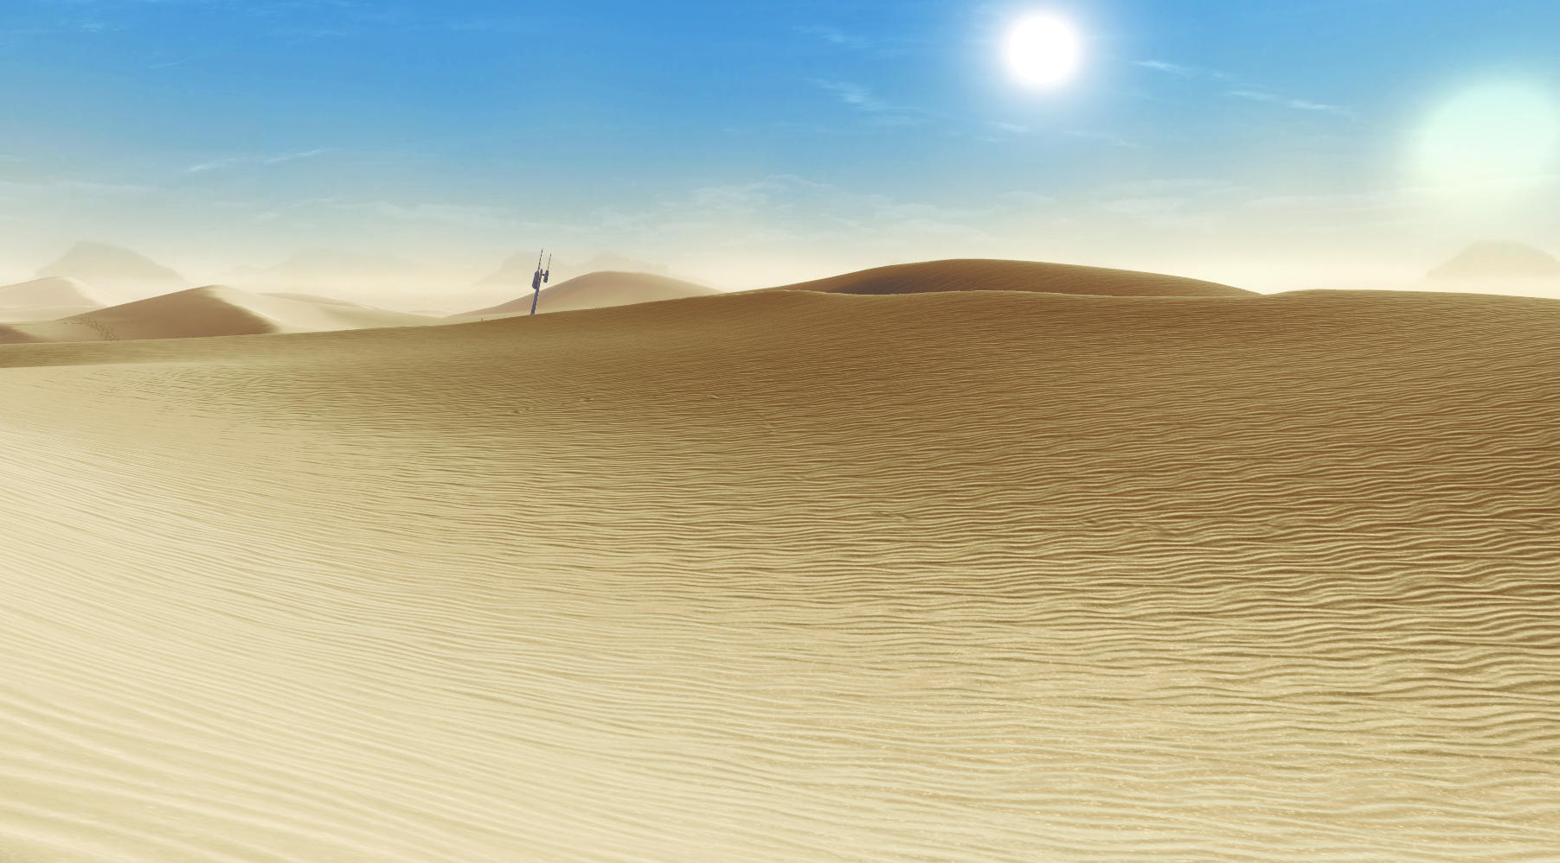
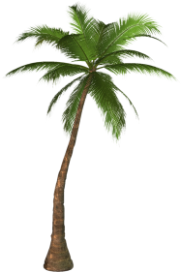
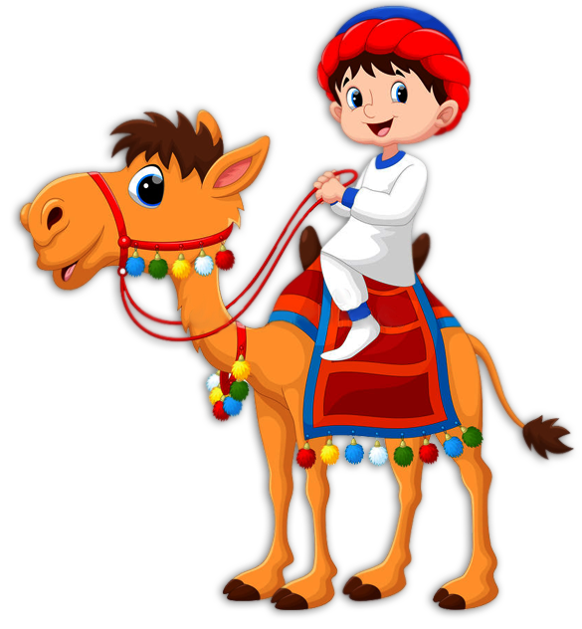


MIRAGE IN DESERT
DENSER
RARER
Inverted image of the
tree is seen

Slide 6
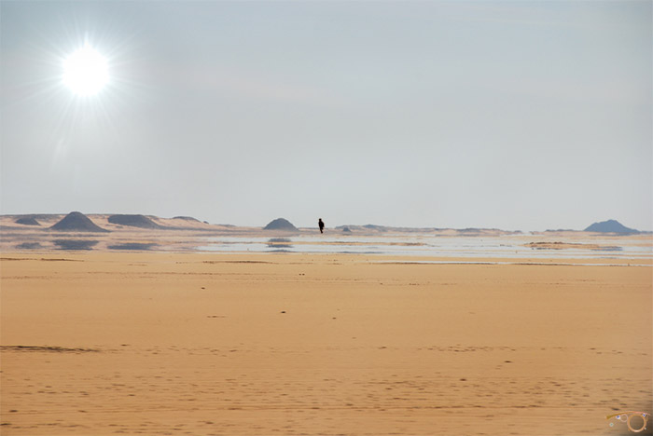
The water that you can see is actually the reflection of blue sky on the ground due to mirage.

Slide 7
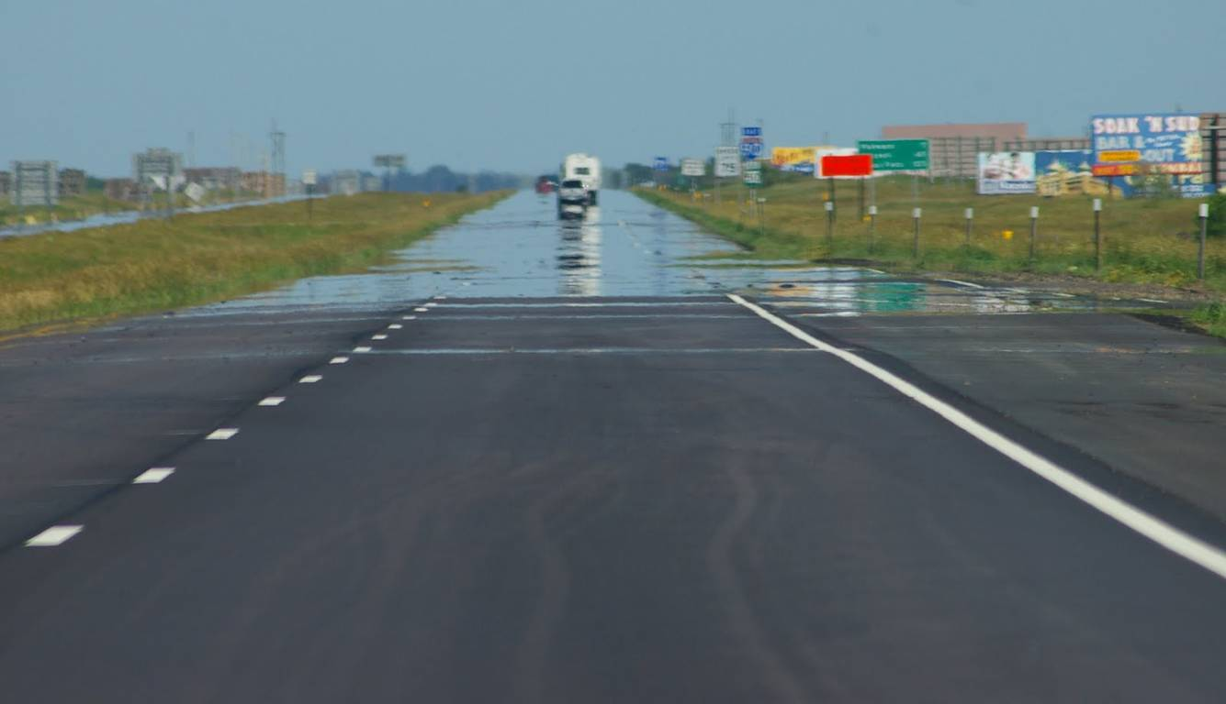
Have you seen water on highway on roads in summer season on a hot afternoon ?
For mirage to occur there has to be TOTAL INTERNAL REFLECTION
Two conditions :-
1. Light should travel from denser medium to rarer medium.
2. Light should hit at an angle greater than critical angle.

Slide 8
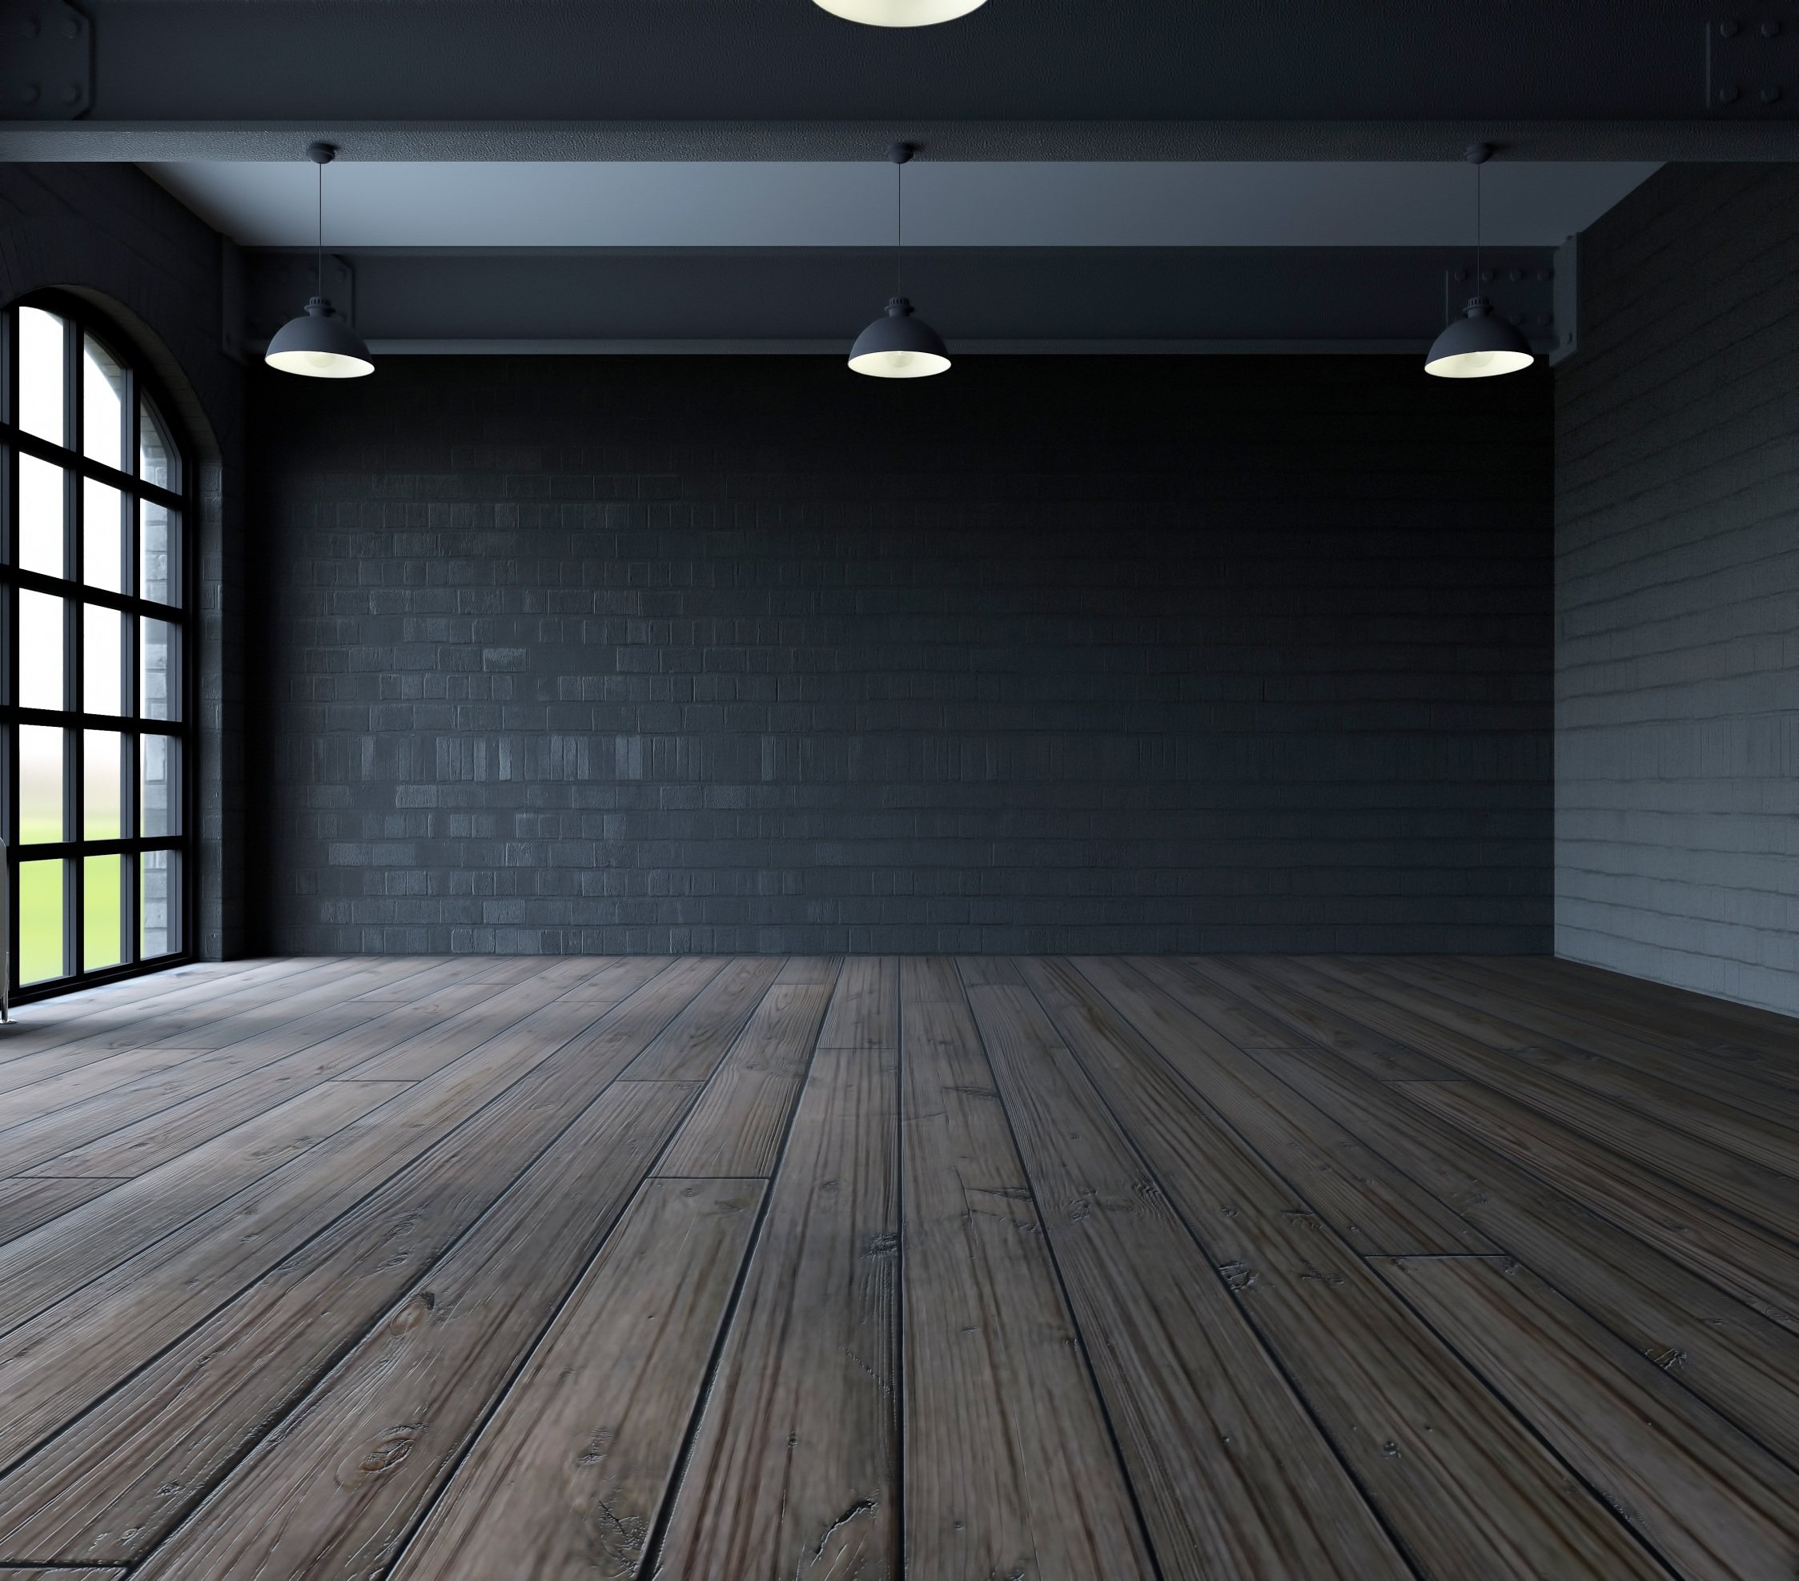
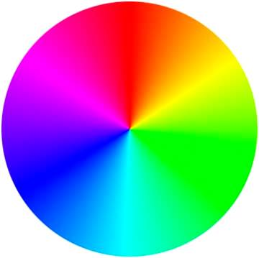
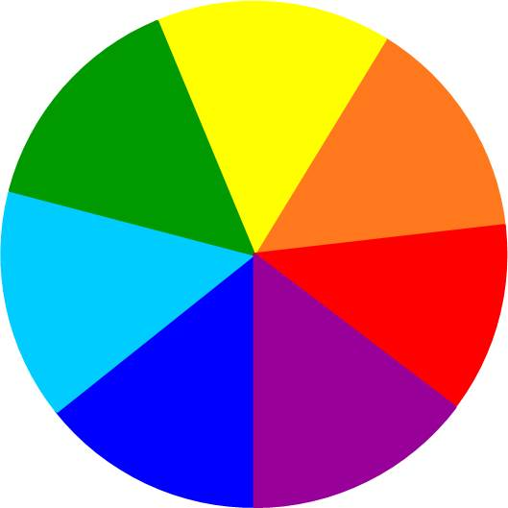
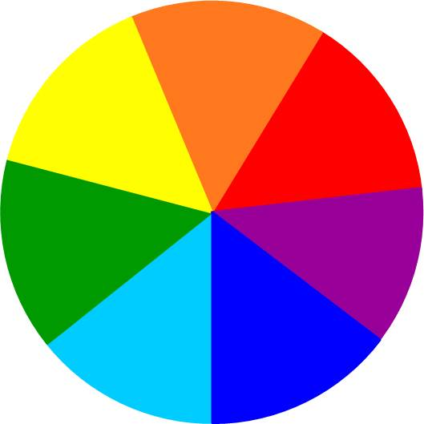
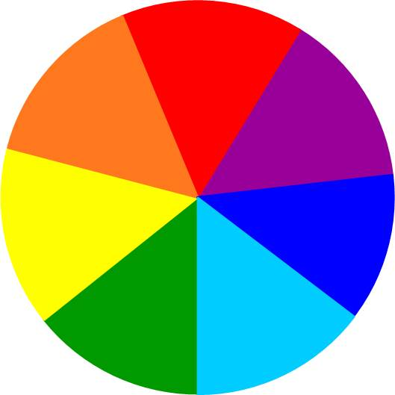
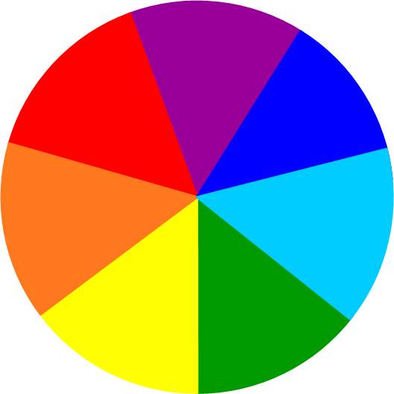
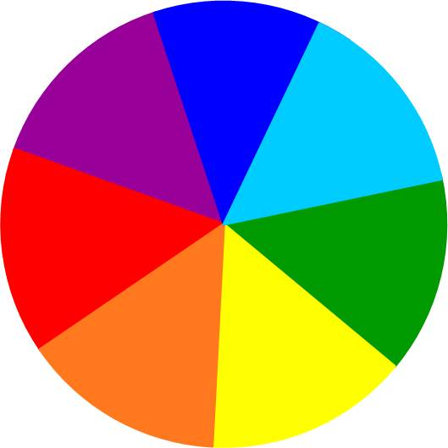
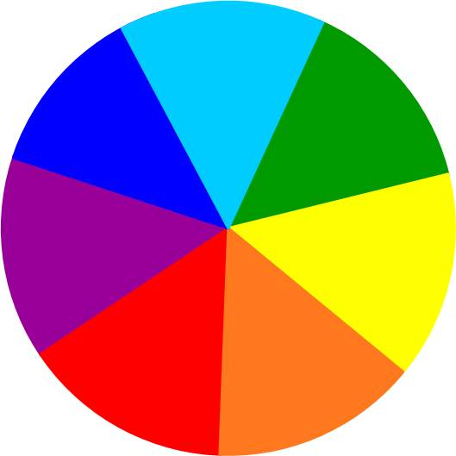
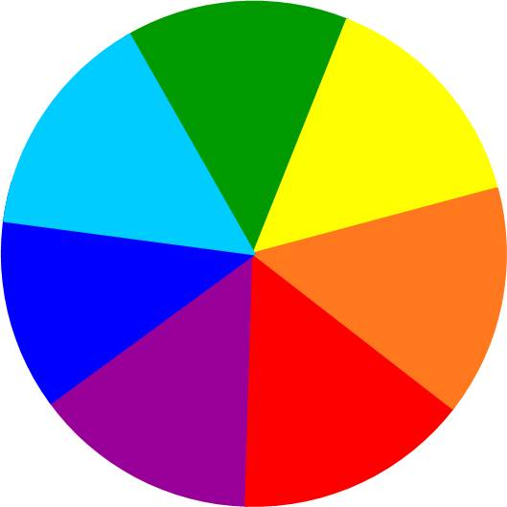
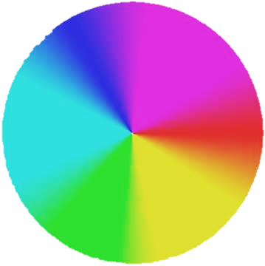
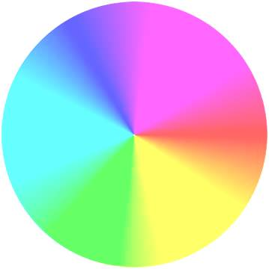
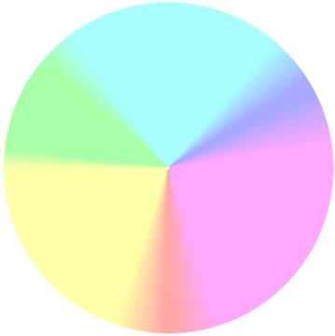

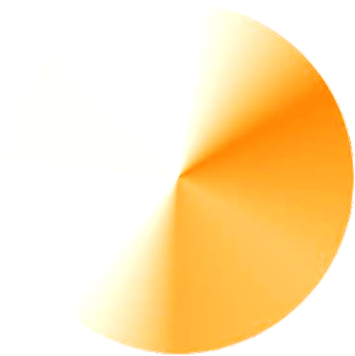
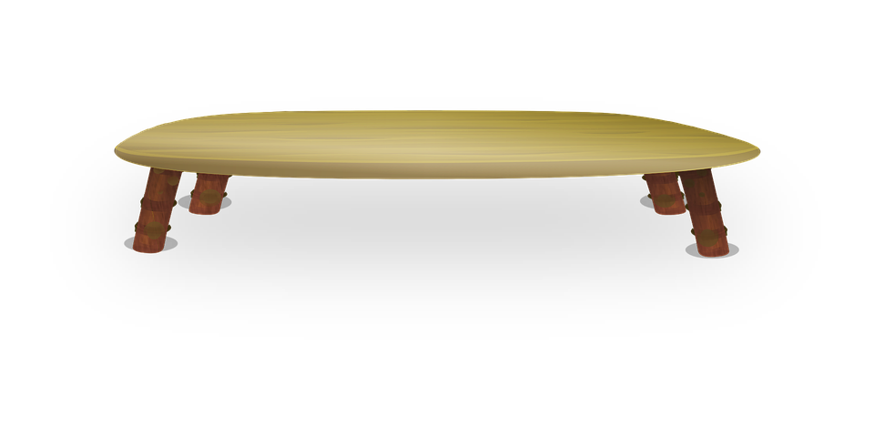
(NEWTON’S EXPERIMENT)
DISPERSION OF WHITE LIGHT
(SIR ISAAC NEWTON)
DISPERSION OF WHITE LIGHT
The phenomenon of splitting of white light by a prism into its constituent colours is known as DISPERSION.
The cause of dispersion of white light is the change in speed of light with wavelength.
The band of colours is called the SPECTRUM.
δ_{min}
V_{max}
Red
δ_{max}
R
O
Orange
Y
Yellow
Green
G
V_{min}
Blue
B
I
Indigo
Violet
V

Slide 9

RECOMBINATION OF WHITE LIGHT
Glass can be consider as a combination of two inverted prism.
Hence there is no dispersion in a glass slab
A
E
F
White light
White light
Red
Red
Red
Violet
Violet
Violet
B
C
D

Slide 10
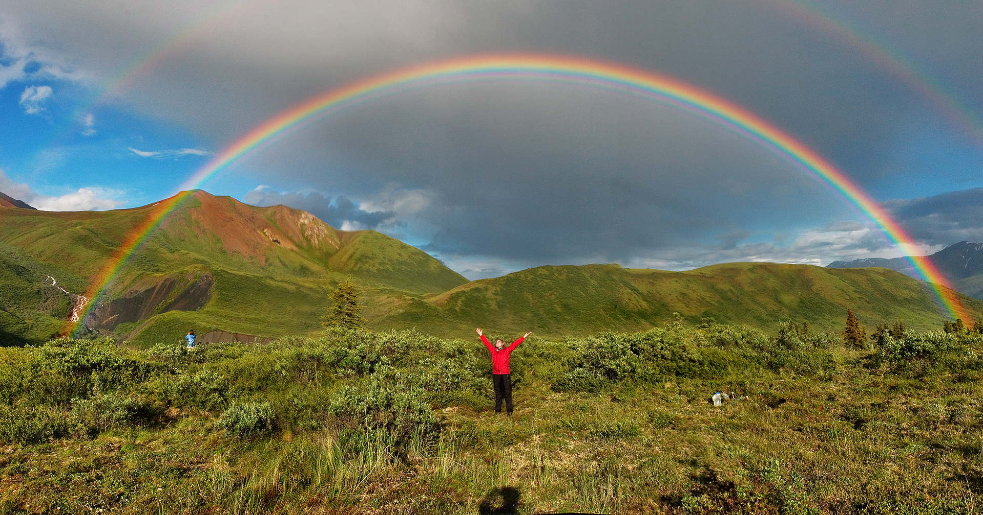
N
I
B
A
O
R
W
The rainbow is an arch of seven colours visible in the sky which is produced by the dispersion of sun’s light by raindrops in the atmosphere.

Slide 11
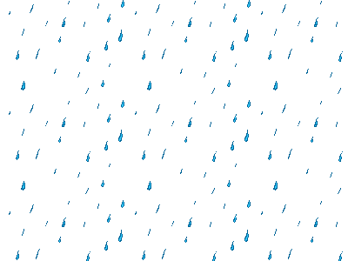
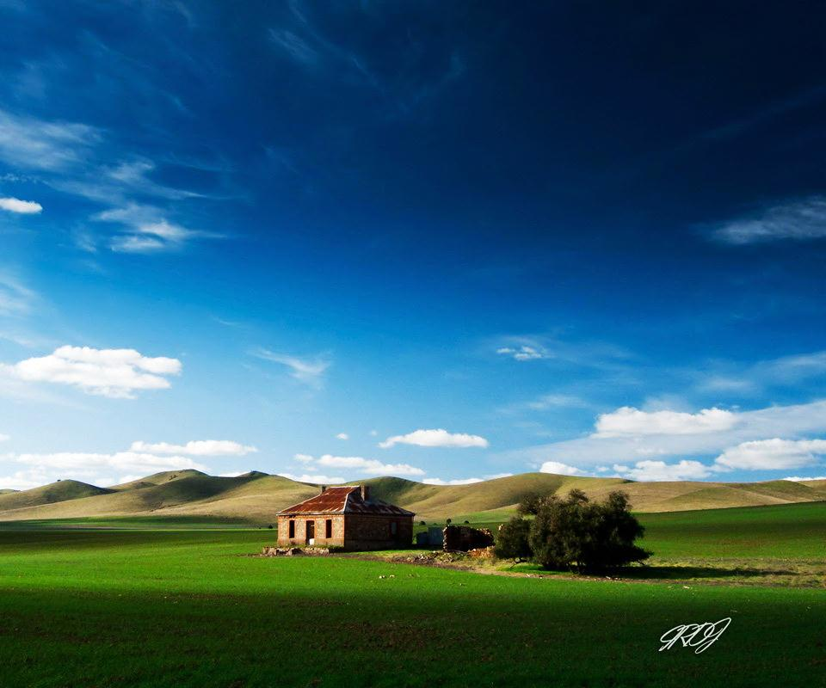
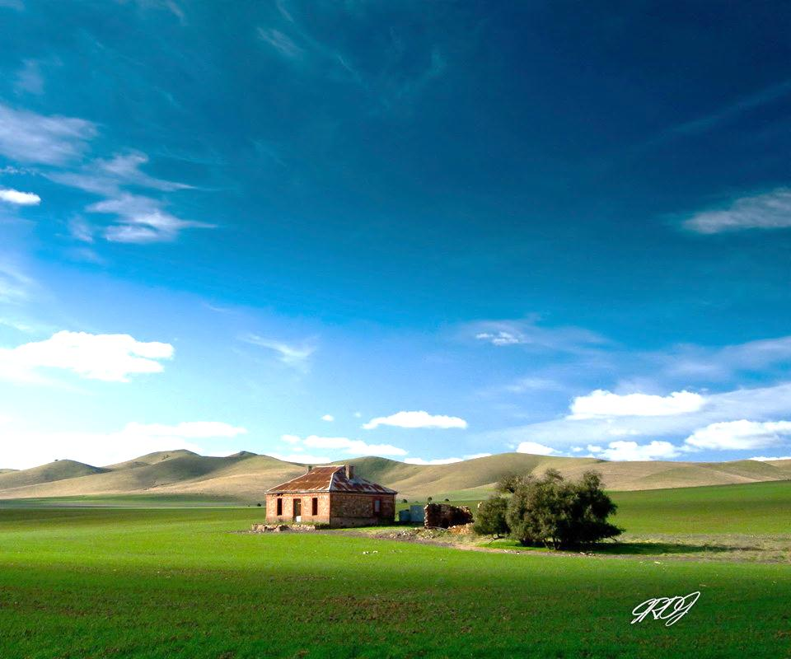


Rainbow Formation
Refraction & Dispersion
Sun
Total Internal Reflection
Raindrop
Rain droplets act like small prisms.
Refraction

Slide 12
Thank You

